Slide 1
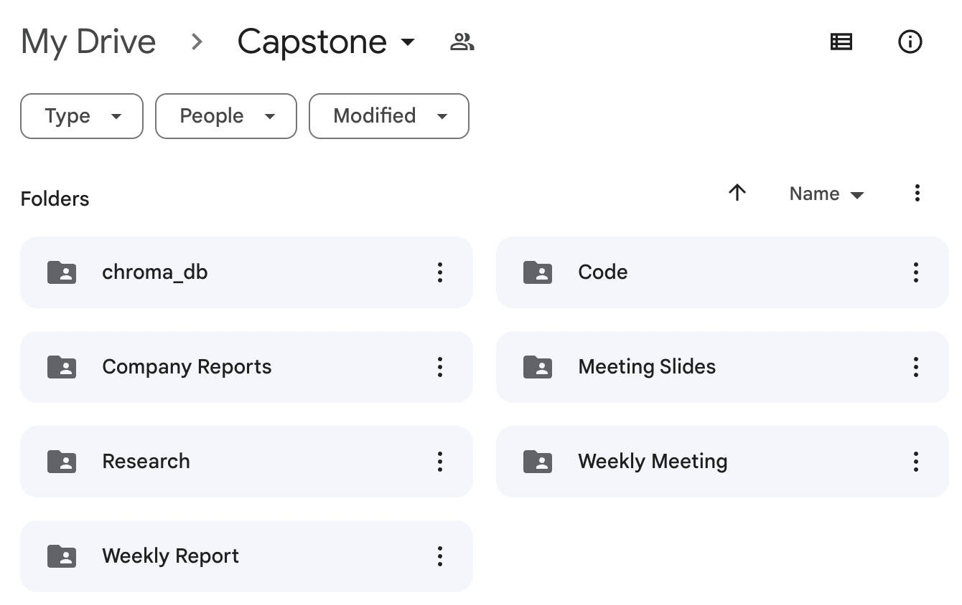
Task Completed in the Past Week
Data
Collected annual reports for 10 target companies in the past 5 years (together)
Research
Research and finalized GPU infra (leo)
Research and finalized Vector Database (yanni)
Research and finalized LLM (alisa)
Research and developed Langchain (jasper)
Research and figured out KPIs to measure (michelle)
Study on FAISS nearest neighbor algorithms (alisa)
Github account creation and structure (michelle)
Code
Q&A model
Conversational model
(leo, jasper combined and wrapped up parts by yanni, alisa, michelle & all reviewed together)

Slide 2
Challenges Encountered
Problem
FAISS, as one of the most advanced similarity search techniques is a library but not traditional vector database, which we are not familiar with and not sure whether it can perform well on our use-case.
Solution
List the basic qualification of our use-case and compare the performance of FAISS with traditional vector database that we have hands-on experience.
Problem
Current structure (Loader/LLM) is not good at getting information from tables and graphs, and thus sometimes fail to find the correct answers to the questions.
Solution
Separate the tables (numerical data) and text in the document using OCR and related techniques, feed different types of data into the model respectively.

Slide 3
The Next Steps for the Project
Selection
Add more data to the database (sustainability reports etc.) (All)
Comparative analysis on vector databases, retriever algorithms, and LLM models (Yi)
Visualization in UI - streamlit (in the future)
Development
Build a summarization model and prepare a demo to showcase (Alisa & Yanni)
Optimization
Improve model itself by RLHF (Reinforcement Learning with Human Feedback) (Jasper & Michelle)
Prompt optimization - see if we can get better answers (All)
Table/graph interpretation - split data (text/numerical/table) (All)

Slide 4
Weekly Report Content
1. Tasks Completed in the Past Week
Briefly enumerate the milestones you or the team have achieved.
Include bullet points to make the slide easy to read.
Use infographics, charts, or diagrams if necessary for enhanced clarity.
Example:
Completed data collection for XYZ variables.
Conducted preliminary data analysis.
Drafted introduction section of the paper.
2. Challenges Encountered
Mention any obstacles or difficulties faced during the week.
Explain how you overcame them or plan to tackle them.
Example:
Faced difficulty in automating the data collection process.
Solved by modifying the existing algorithm to improve efficiency.
3. The Next Steps for the Project
Clearly define the objectives for the upcoming week.
These should be SMART goals (Specific, Measurable, Achievable, Relevant, Time-bound).
Example:
To finalize the literature review by [Date].
To conduct interviews for qualitative data collection by [Date].

